Slide 1

BANKRUPTCY PREVENTION
Project Code : P - 406
Group - 5
Project Members :
Swati Rajput
Kamlesh Ramchandra Jadhav
Ashutosh R. Dhakulkar
Manasvi Dhananjay Bagal
Prathamesh Chandrakant Sathe
Imaduddin Khoobtar

Slide 2
Project Work Flow
Start
Fetch Data
Data Cleaning
EDA
Data Splitting
Training Data
Test Data
Feature Selection
Train Model
Predict Data
Performance Measure

Slide 3



CONTENT
Business Problem
Business Objective
Solutining Approach
Exploratory Data Analysis
Model Building

Slide 4

BUSINESS PROBLEM :
Prevention of Companies going Bankrupt.
BUSINESS OBJECTIVE :
This is a classification project, since the variable to predict is binary (bankruptcy or non- bankruptcy).
The goal here is to model the probability that a business goes bankrupt from different features.
Solutioning Approach:
In EDA, we will explore and analyze the dataset to understand its main characteristics, detect patterns, spot anomalies, and check assumptions.
Depending on the problem type, we will choose appropriate algorithms which will give best accuracy. Since this is a classification problem it includes Logistic Regression, Decision Trees, Random Forests, SVM, XG-Boost etc.
For the deployment part we will be using either Flask / Streamlit.

Slide 5
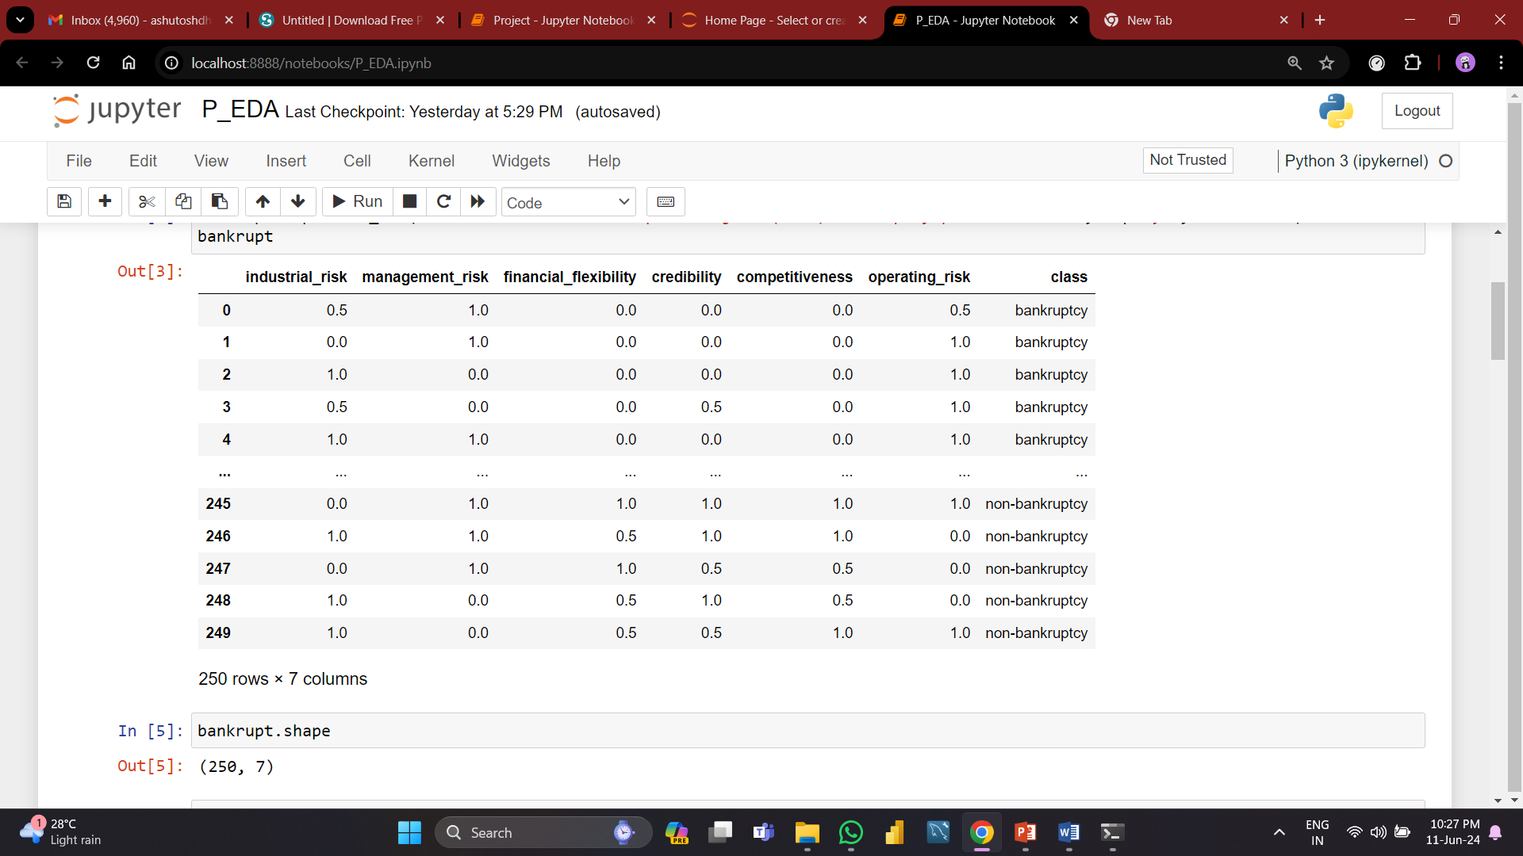
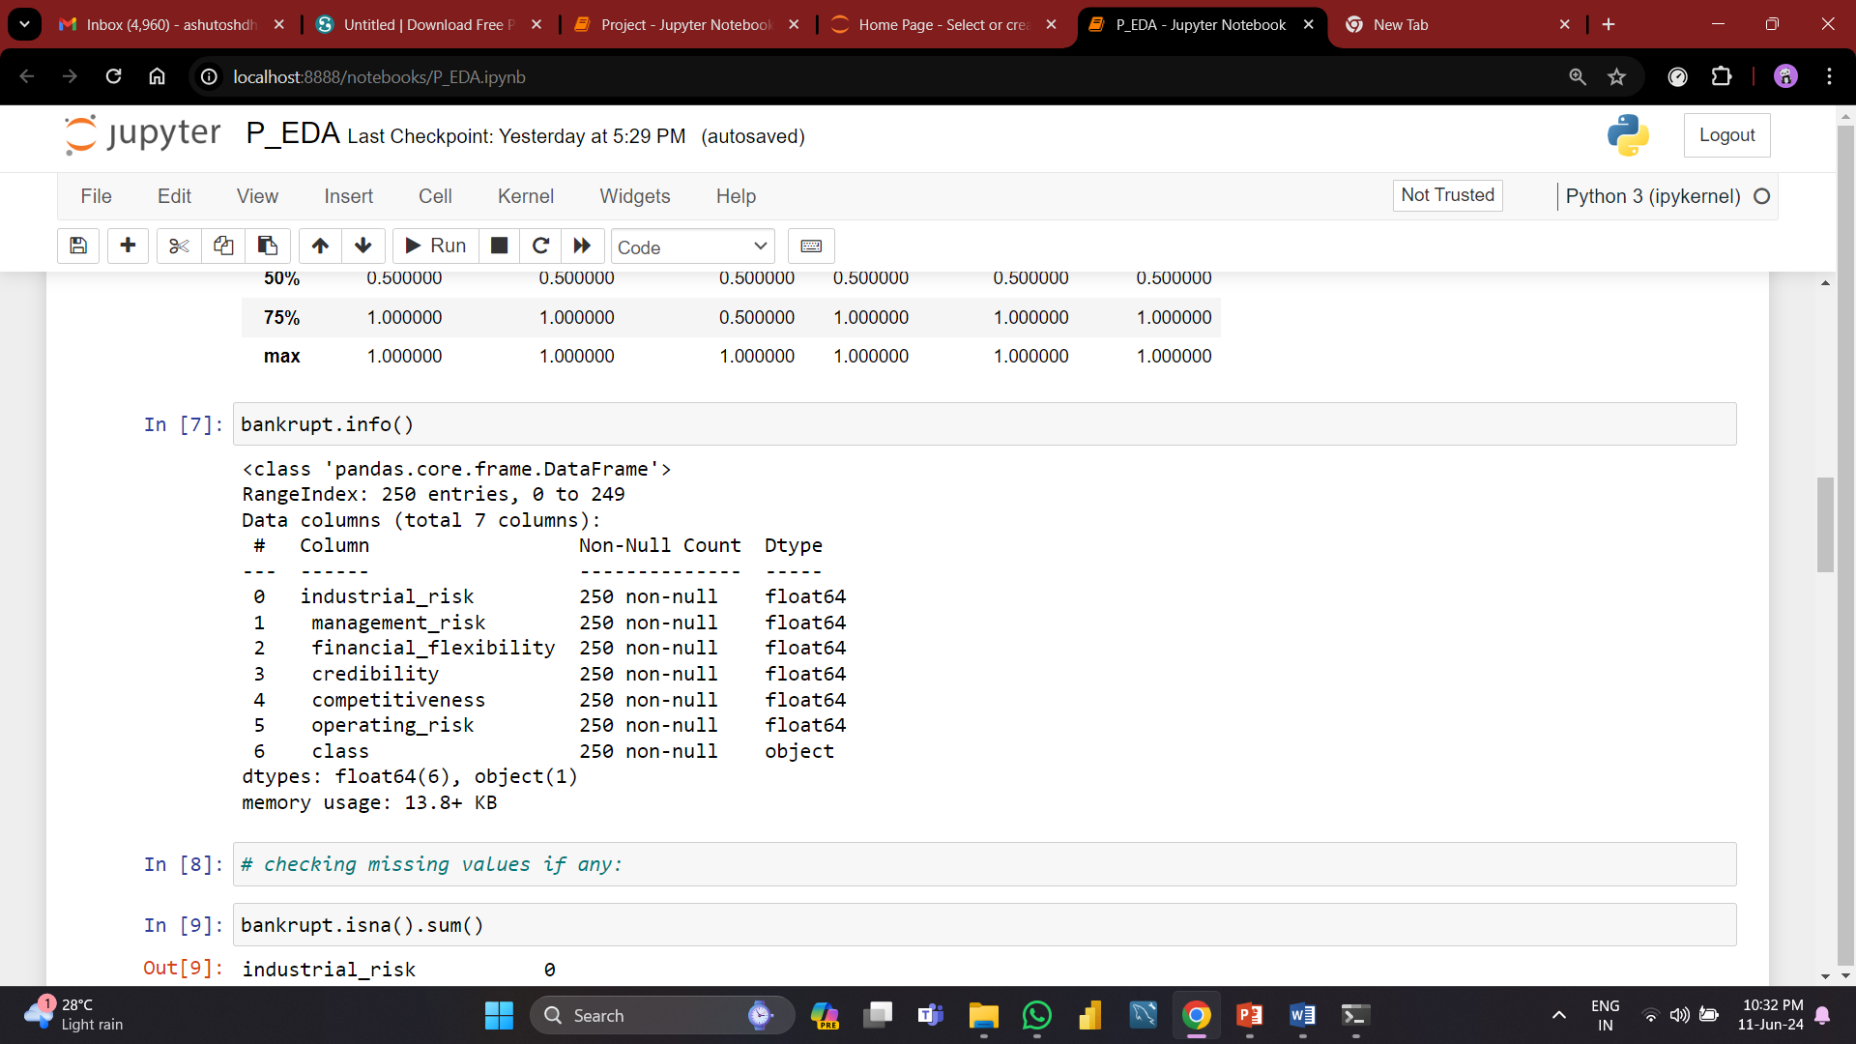
Exploratory Data Analysis (EDA):
Insight information:
Based on our examination of the dataset, we can conclude that it has all the information needed to determine whether a company is bankrupt or not.
Of the seven columns in the dataset, one(class column) is a target variable, and the remaining columns are features. By using these features, we will be able to determine if a certain company is bankrupt or not.
About The Dataset:
DATA : DATA INFROMATION :

Slide 6
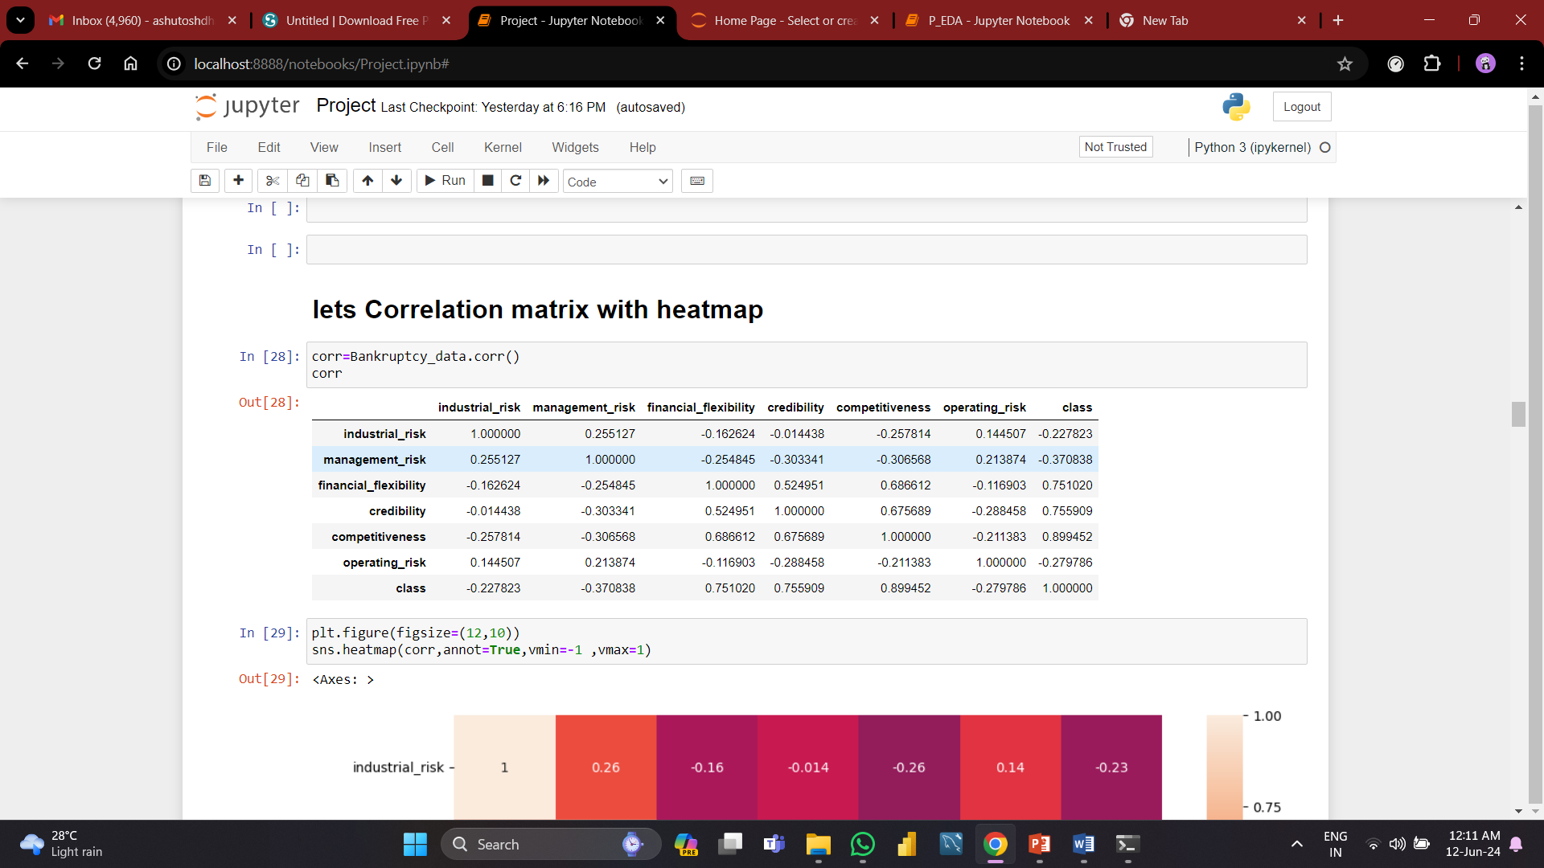
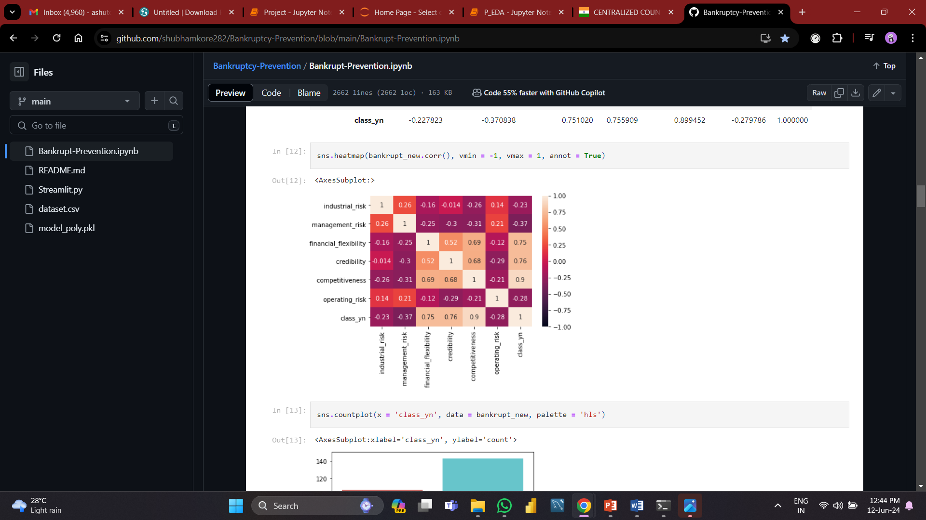
Correlation Analysis
Following is our analysis of the correlation matrix and correlation heat-map, we are able to determine the correlation between the target variable and its features.
For instance, the features "financial flexibility," "credibility" and "competitiveness" have strong correlations with the target variable (correlation values of 0.751020, 0.759509, and 0.89452), respectively, and the remaining features have less correlations with the target variable ( correlation value for the remaining feature less than 0.5).
After analyzing the aforementioned data, we can conclude that a company or business bankruptcy or not depends more on its "financial flexibility," "credibility," and "competitiveness" features. These features are the most crucial ones to consider while creating a classification model.

Slide 7
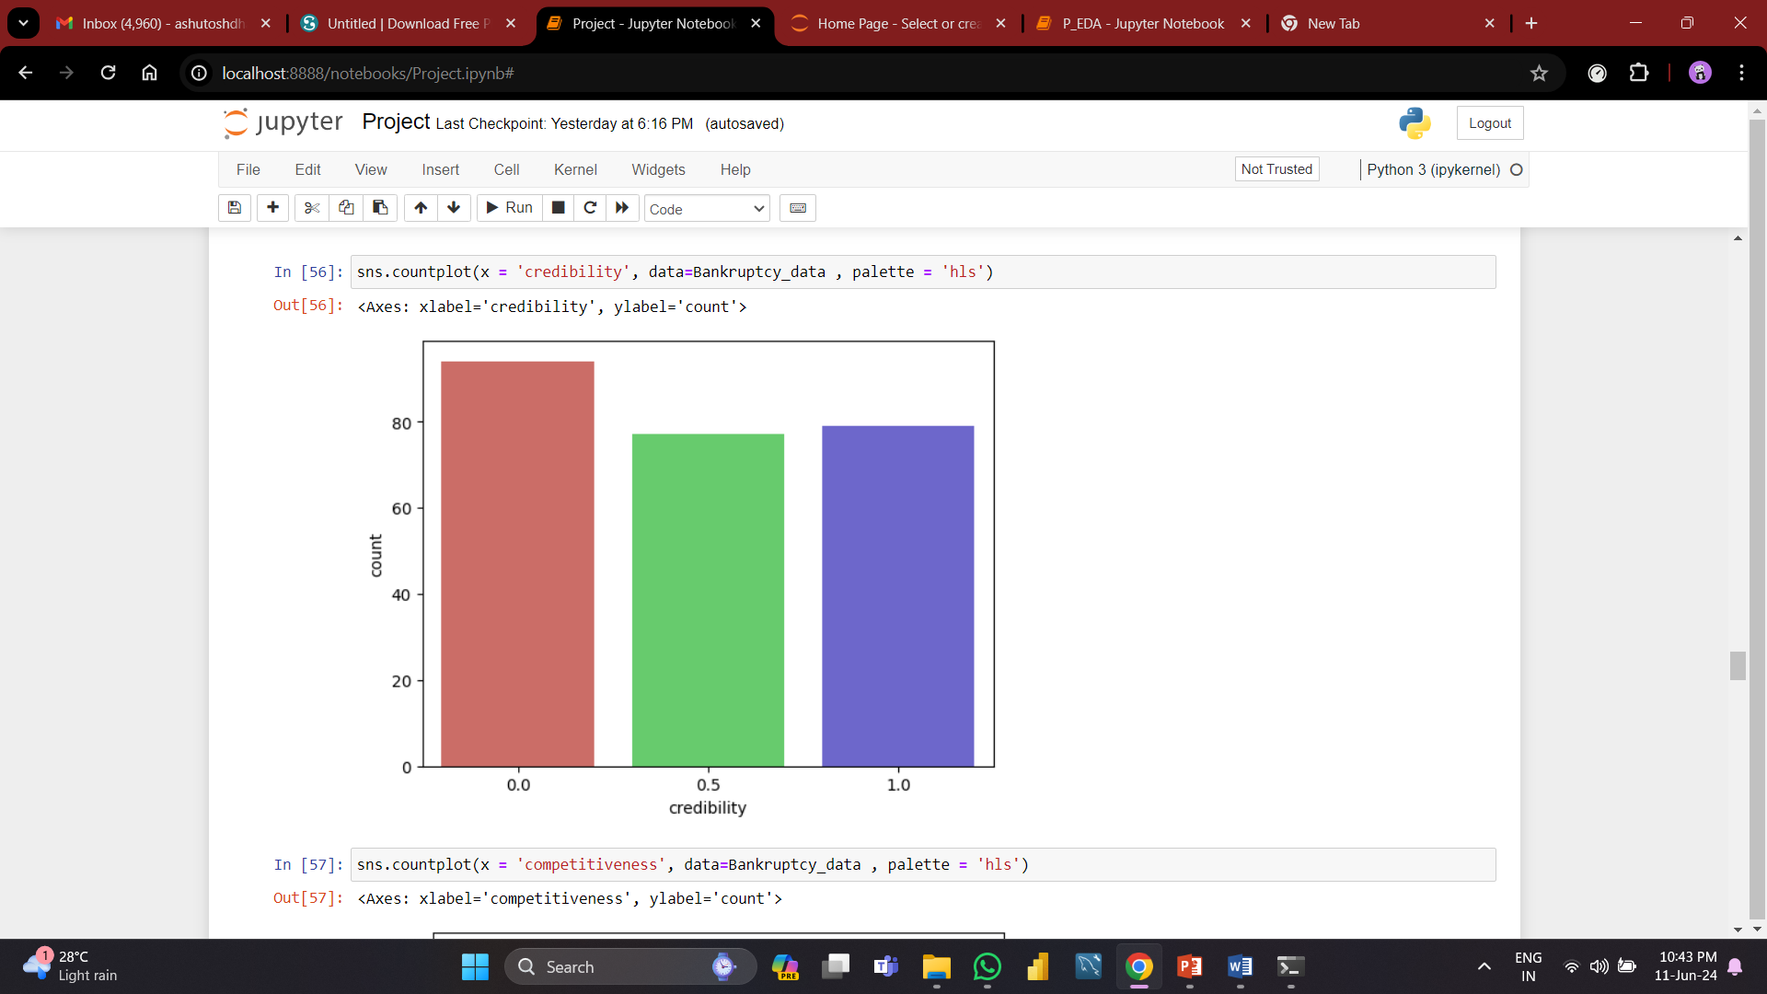
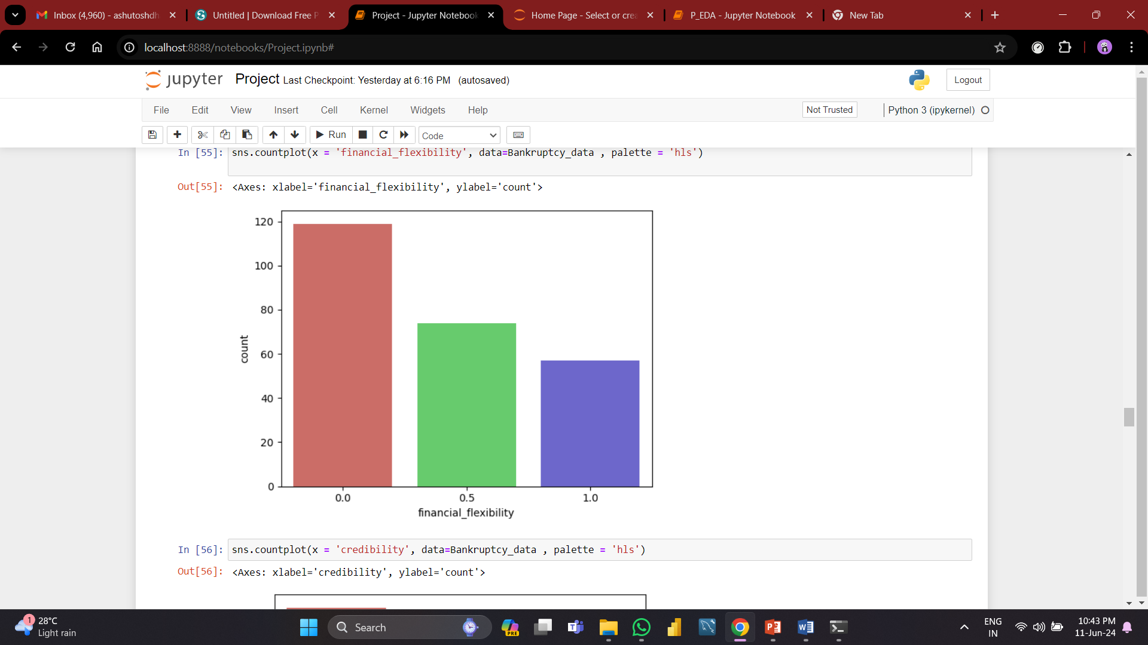
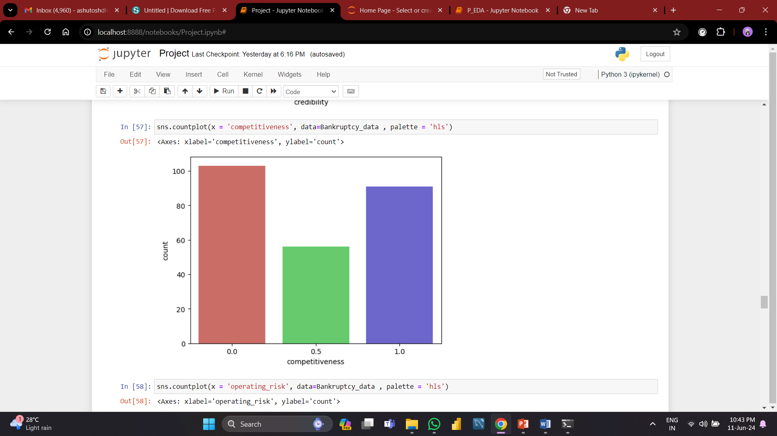
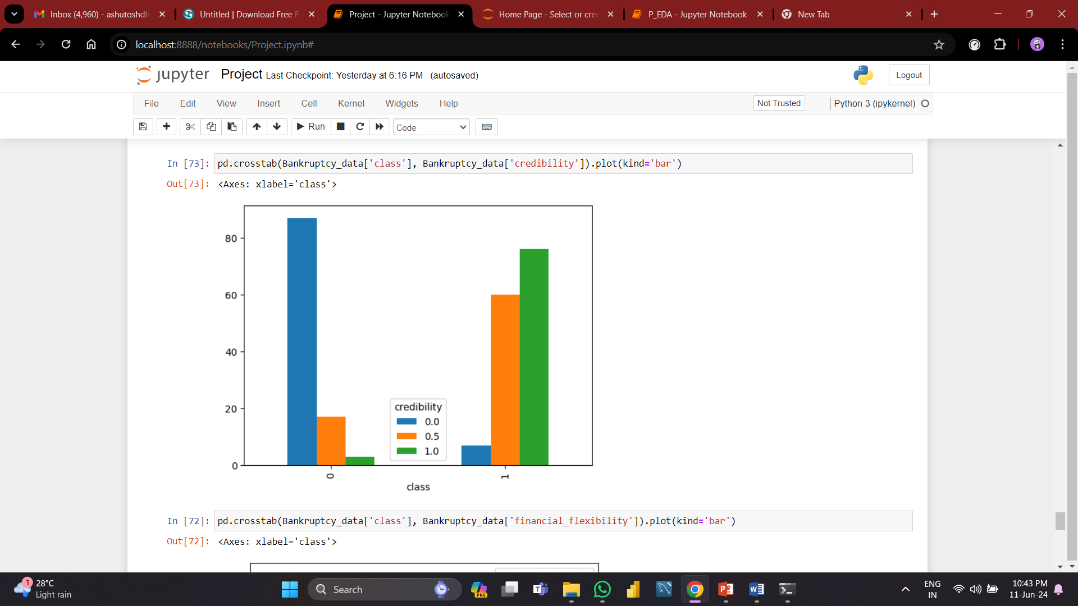
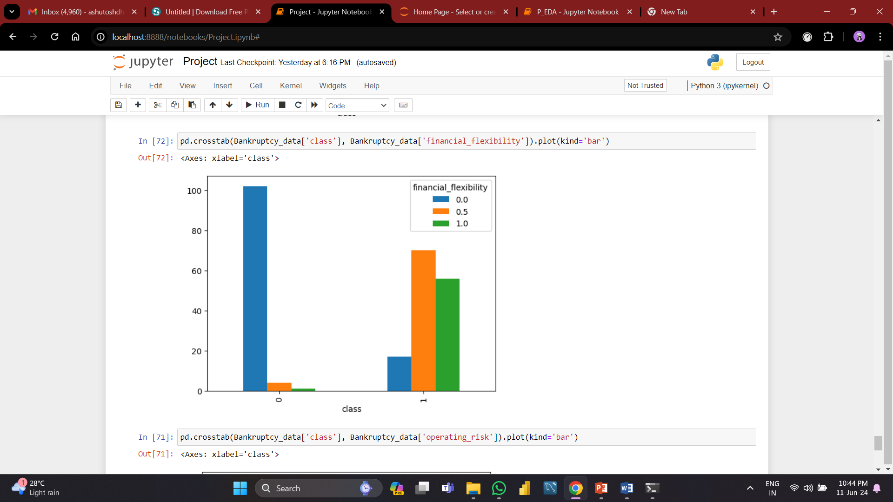
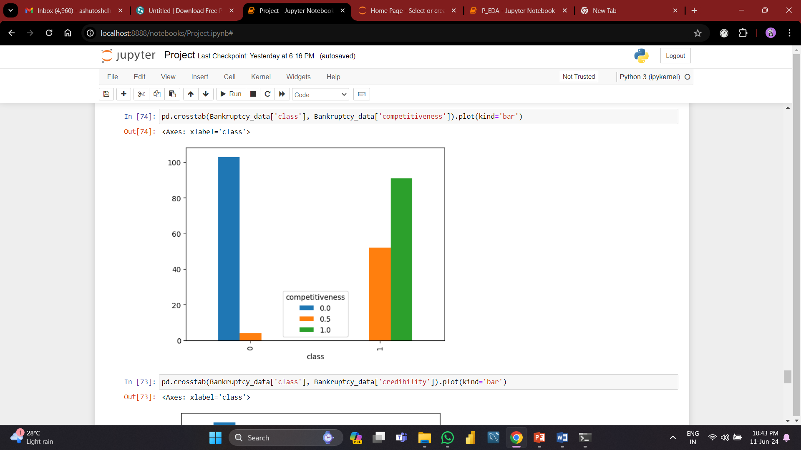
About The Dataset (Count Plot):
Since the features financial flexibility, credibility and competitiveness have strong correlations with the target variable, we tried to represent the same using different plots.
Visualizing Crosstab Independent features With Class Column

Slide 8

Model Building
So in the model building we tried various models mentioned below with the aim to find best accurate model :
Logistic Regression
KNN ( K-Nearest Neighbors )
Naive Bayes Classifier
Support Vector Machine
Model Performance
Selection of the best Model

Slide 9
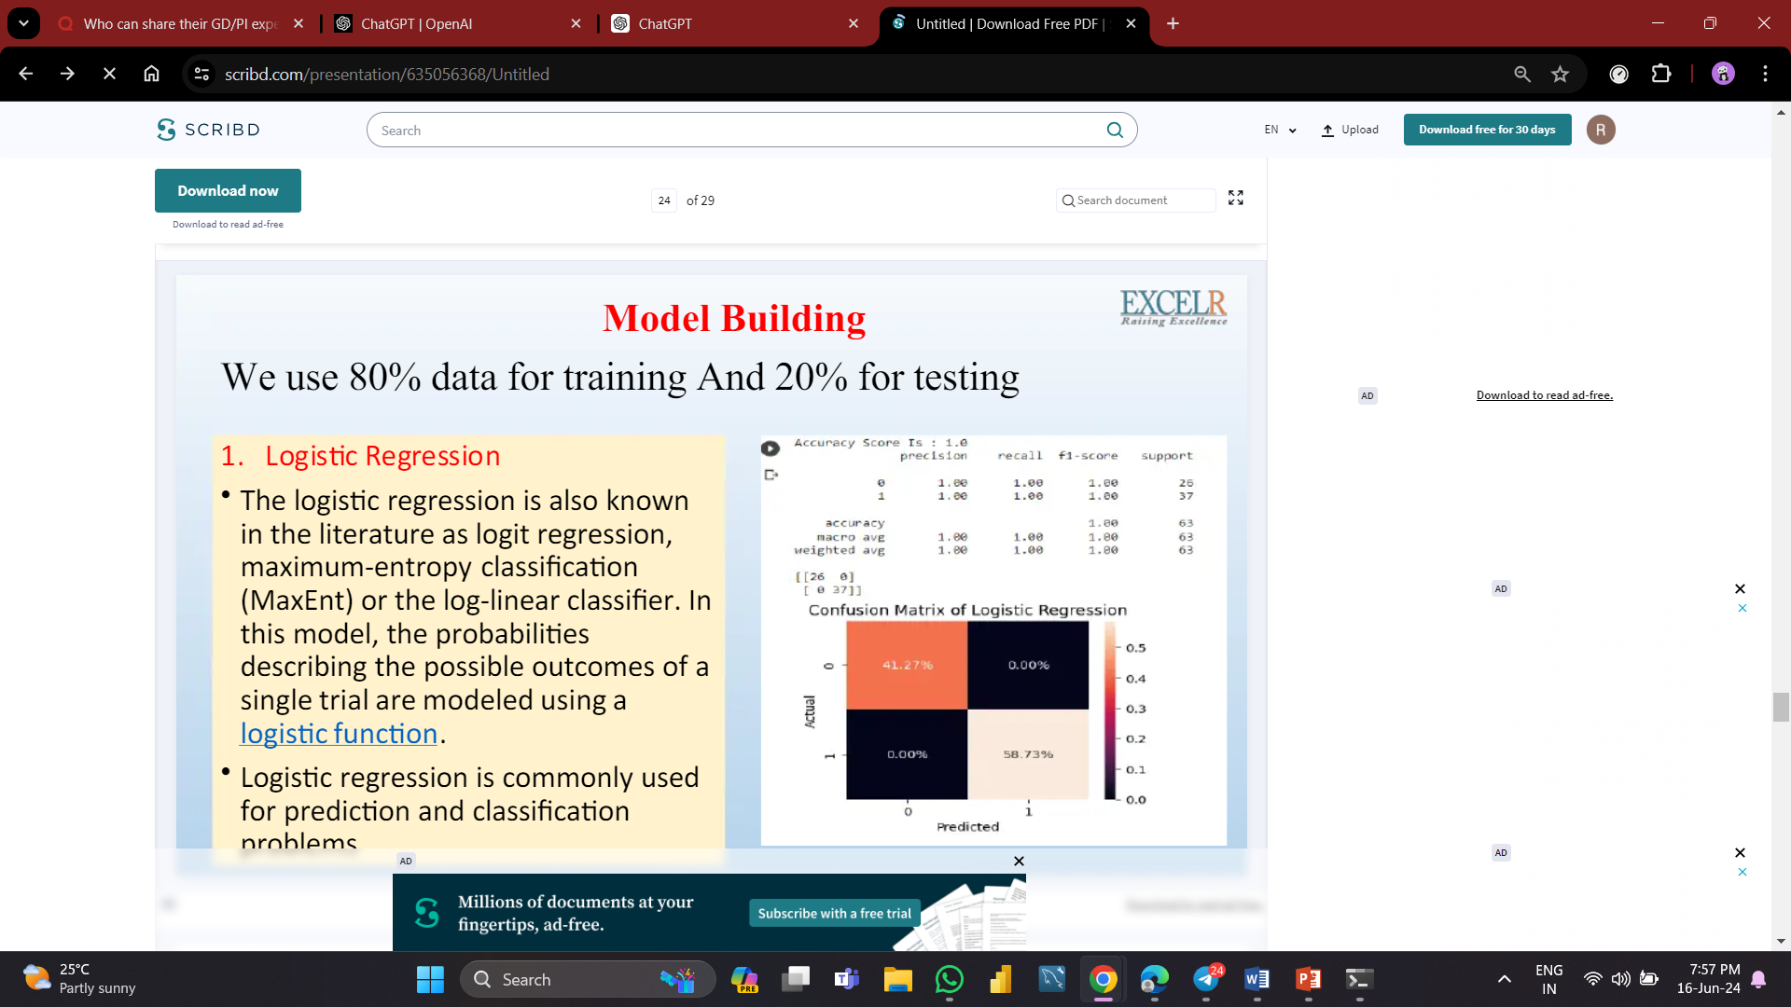
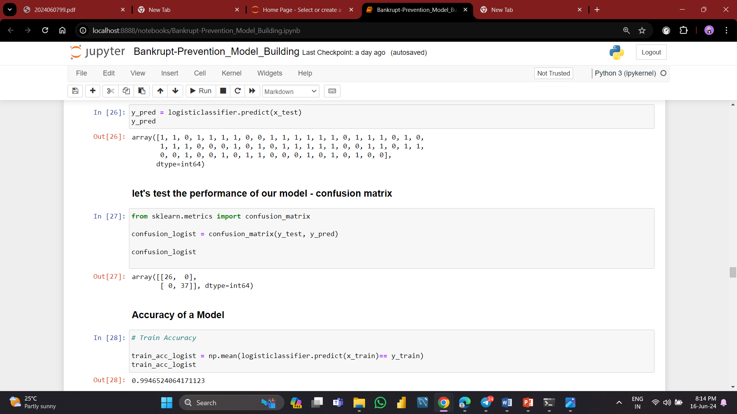
Logistic Regression
We will use 75% data for training and 25% data for testing purpose.
Logistic Regression is also known as Logit Regression, Maximum-Entropy Classification or the Log-Linear Classification.
In this model, the probabilities describing the possible outcomes of a single trial are modeled using a logistic function.
Logistic Regression is commonly used for prediction and classification problems.
From the accuracy we can say that the model is overfitted, to avoid overfitting problem we use Regularization method here we have L1, L2 regularization.
It turns out they have different but equally useful properties.

Slide 10
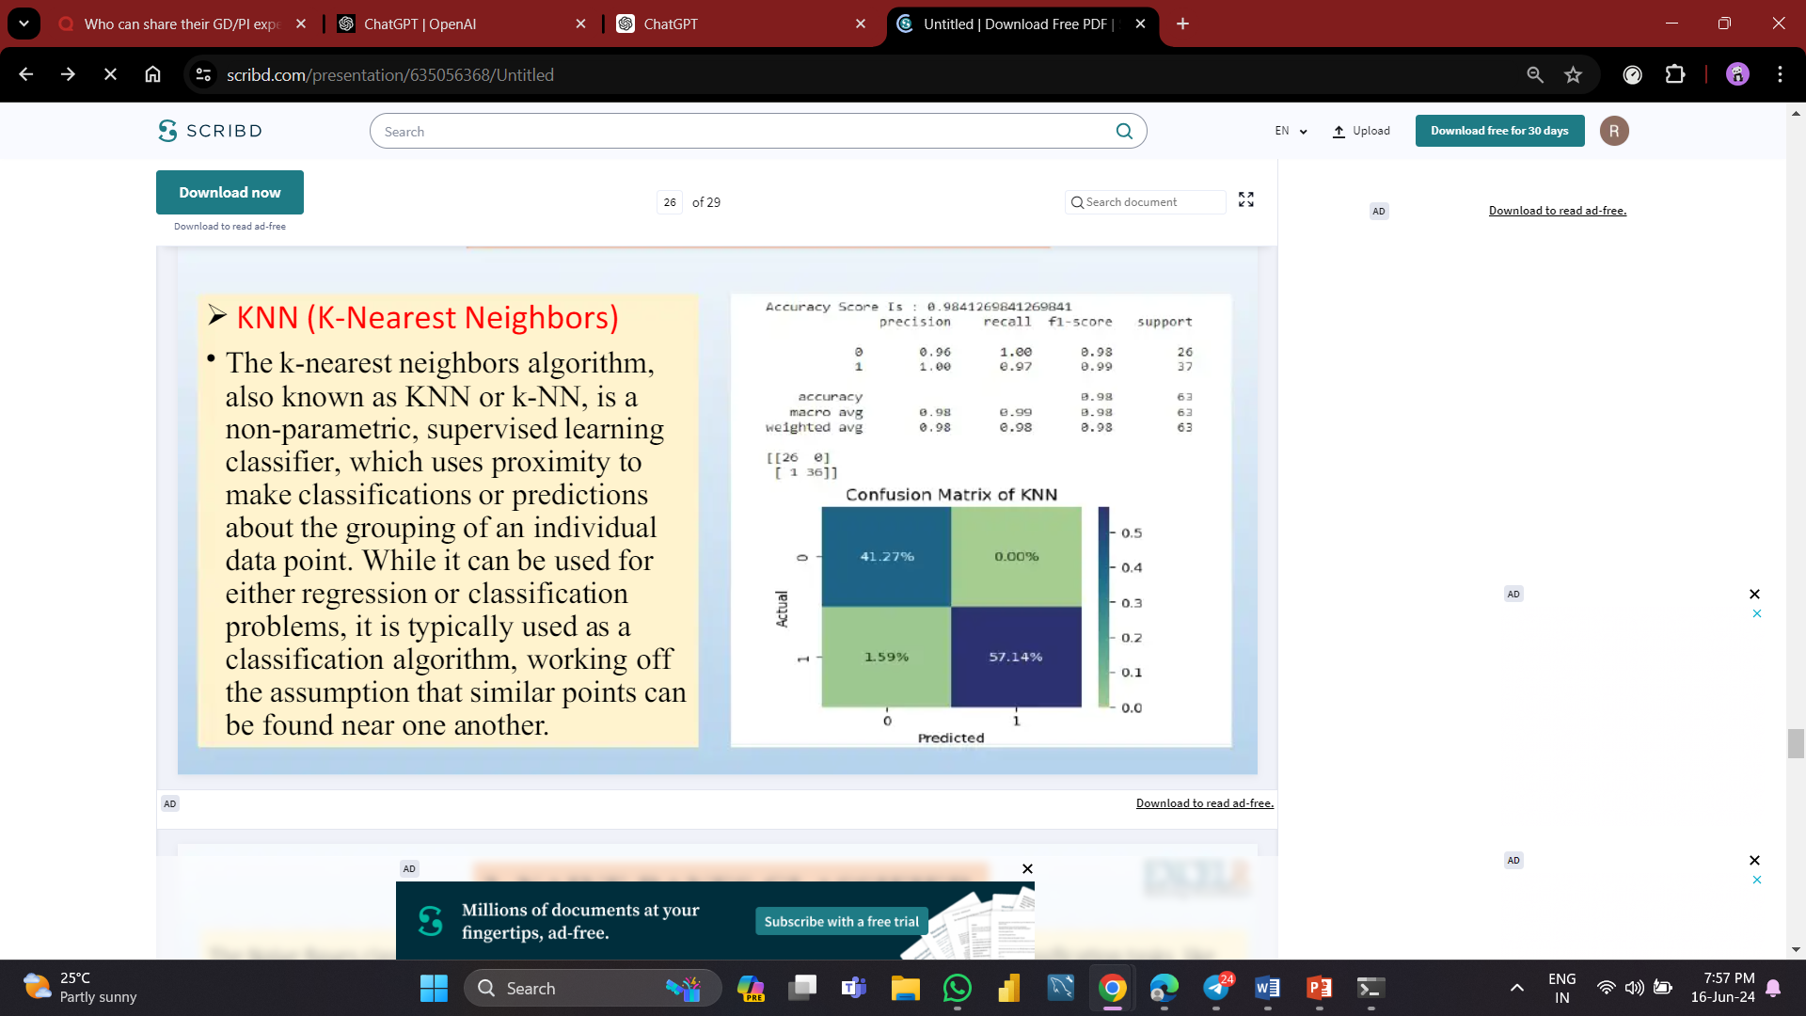
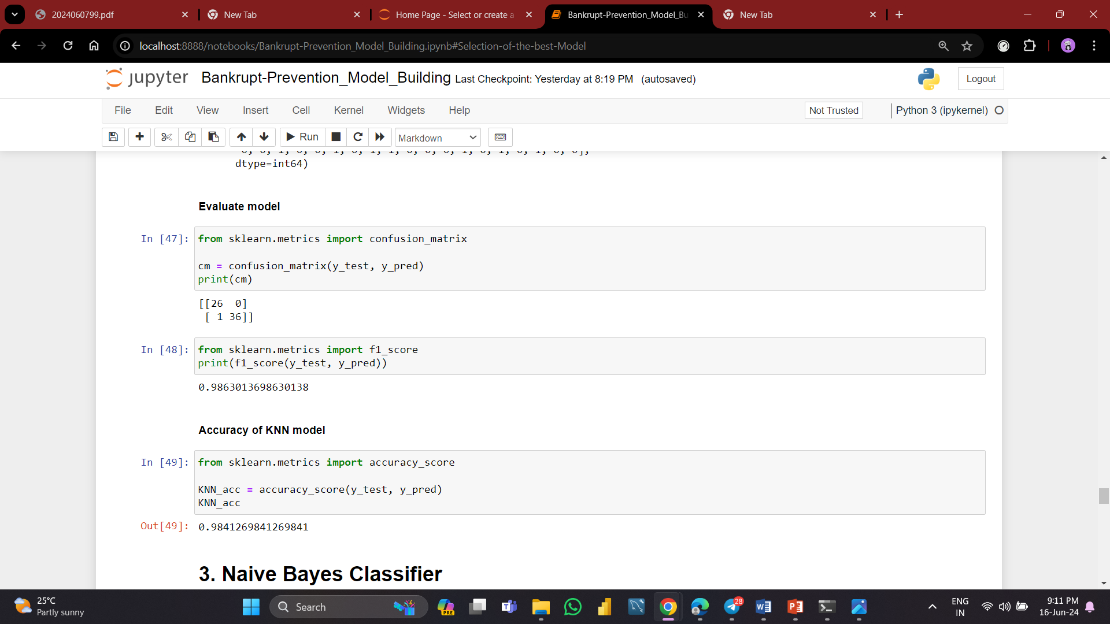
KNN ( K-Nearest Neighbors )
The k-nearest neighbors algorithm, also known as KNN or k-NN, is a non-parametric, supervised learning classifier, which uses proximity to make classifications or predictions about the grouping of an individual data point.
While it can be used for either regression or classification problems, it is typically used as a classification algorithm, working off the assumption that similar points can be found near one another.
Its performance can be significantly influenced by the choice of “k”, the distance metric used, and the scaling of input features, making it essential to carefully consider these aspects when deploying KNN in real-world scenarios.

Slide 11
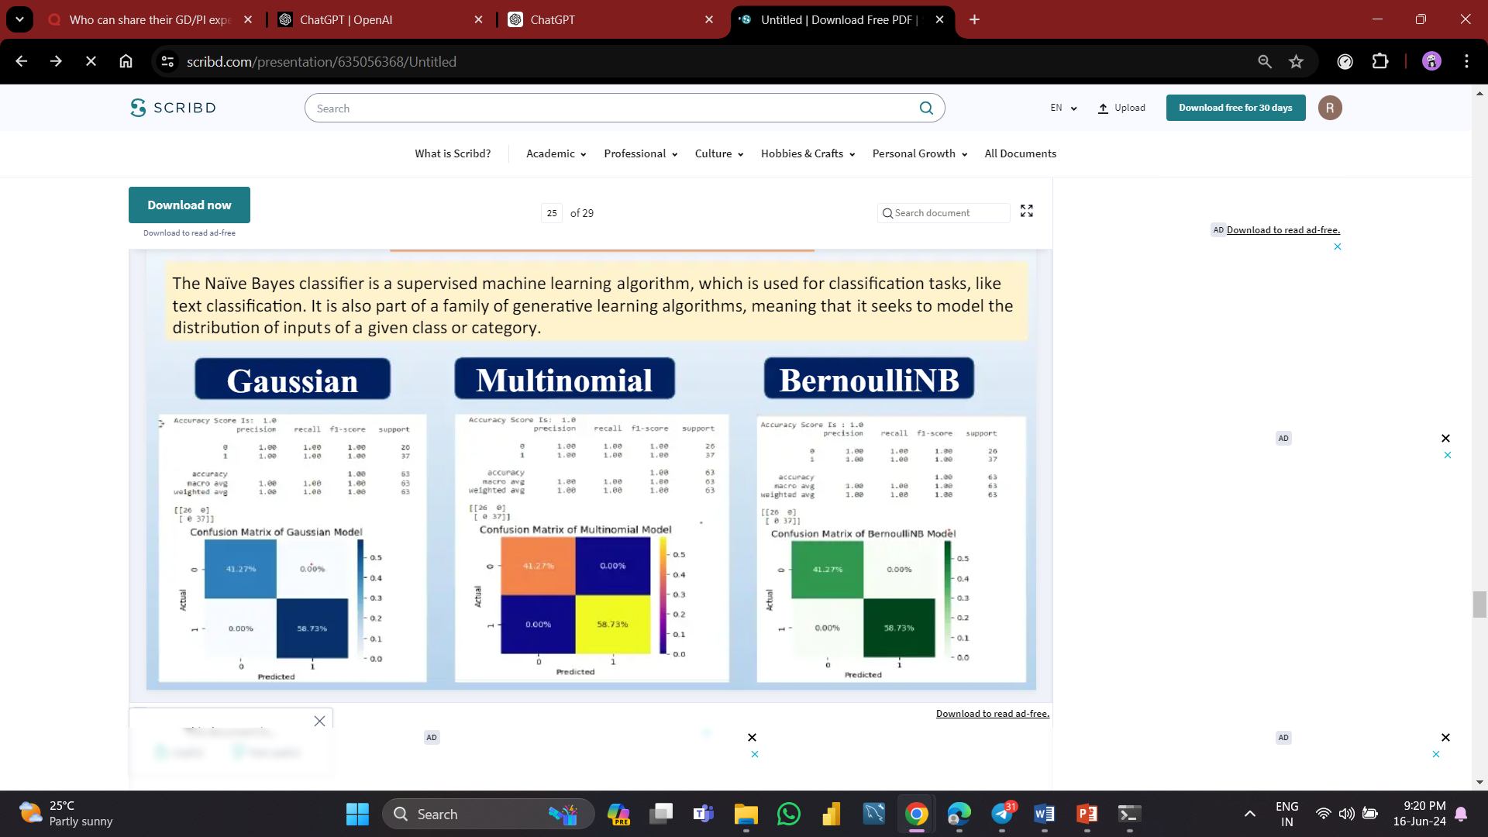
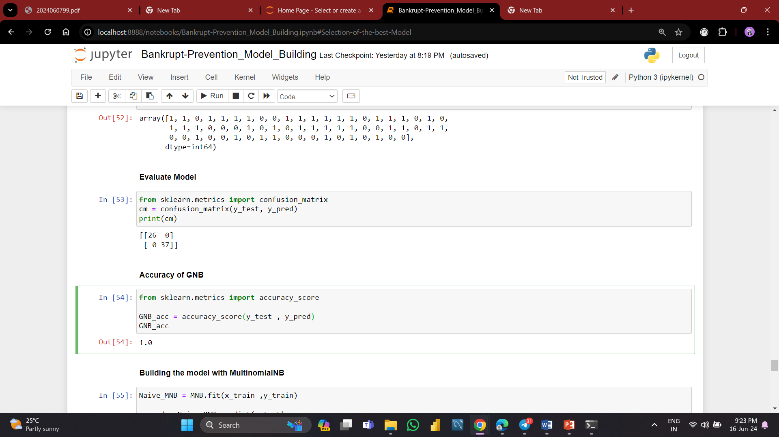
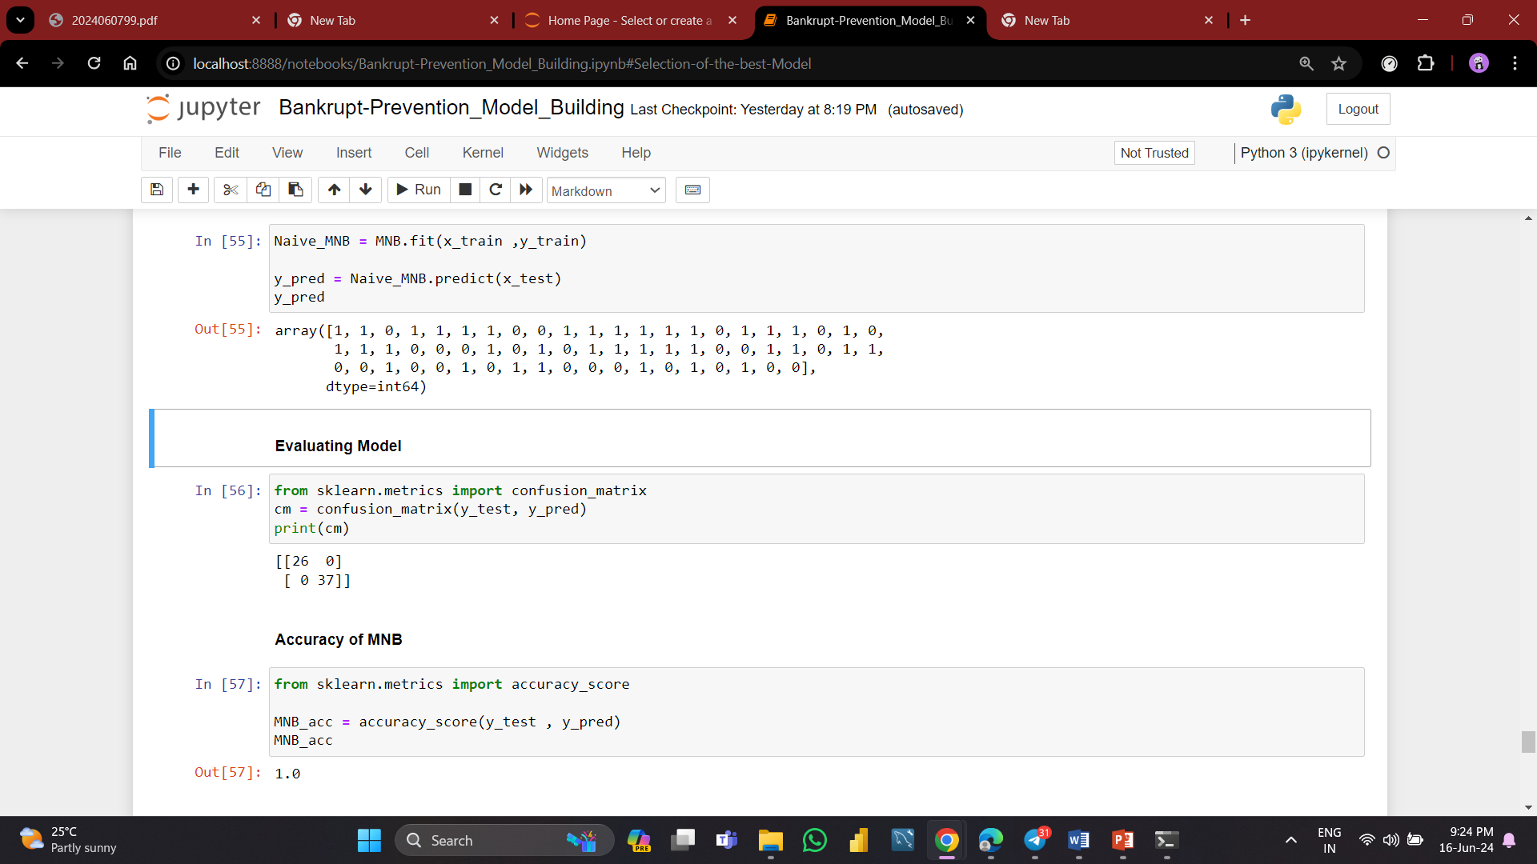
Naive Bayes Classifier
The Naïve Bayes classifier is a supervised machine learning algorithm, which is used for classification tasks, like text classification.
It is also part of a family of generative learning algorithms, meaning that it seeks to model the distribution of inputs of a given class or category.
Gaussian Naive Bayes:
Assumes that the continuous values associated with each feature are distributed according to a Gaussian (normal) distribution.
Suitable for datasets where features are normally distributed.
Multinomial Naive Bayes:
Typically used for discrete feature vectors where features represent the frequency of a particular term (commonly used in text classification).
Assumes that the features follow a multinomial distribution.

Slide 12
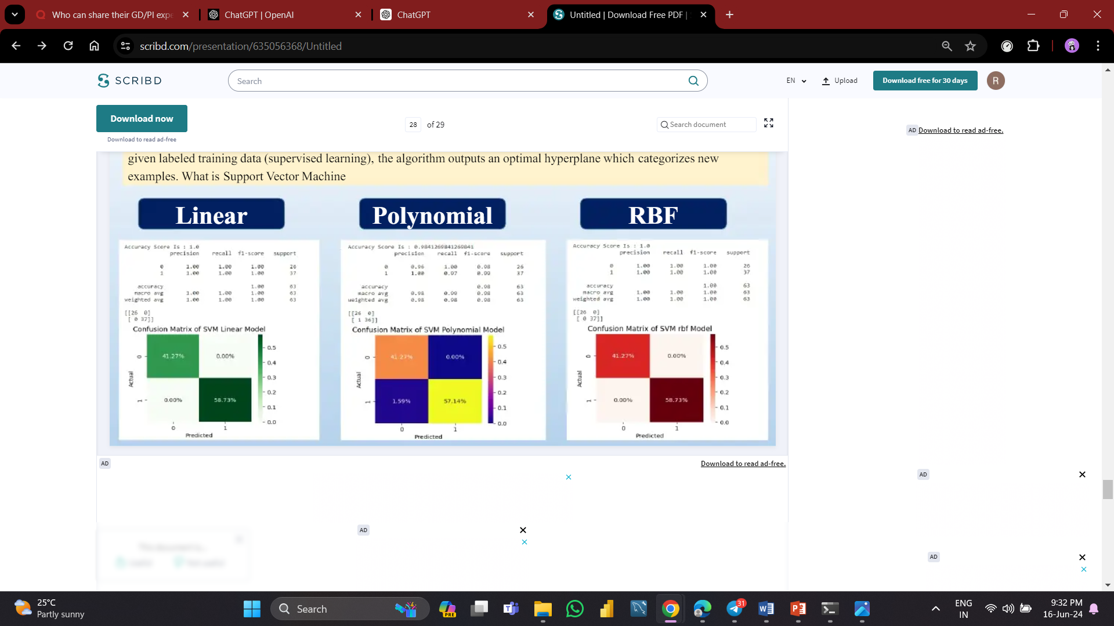
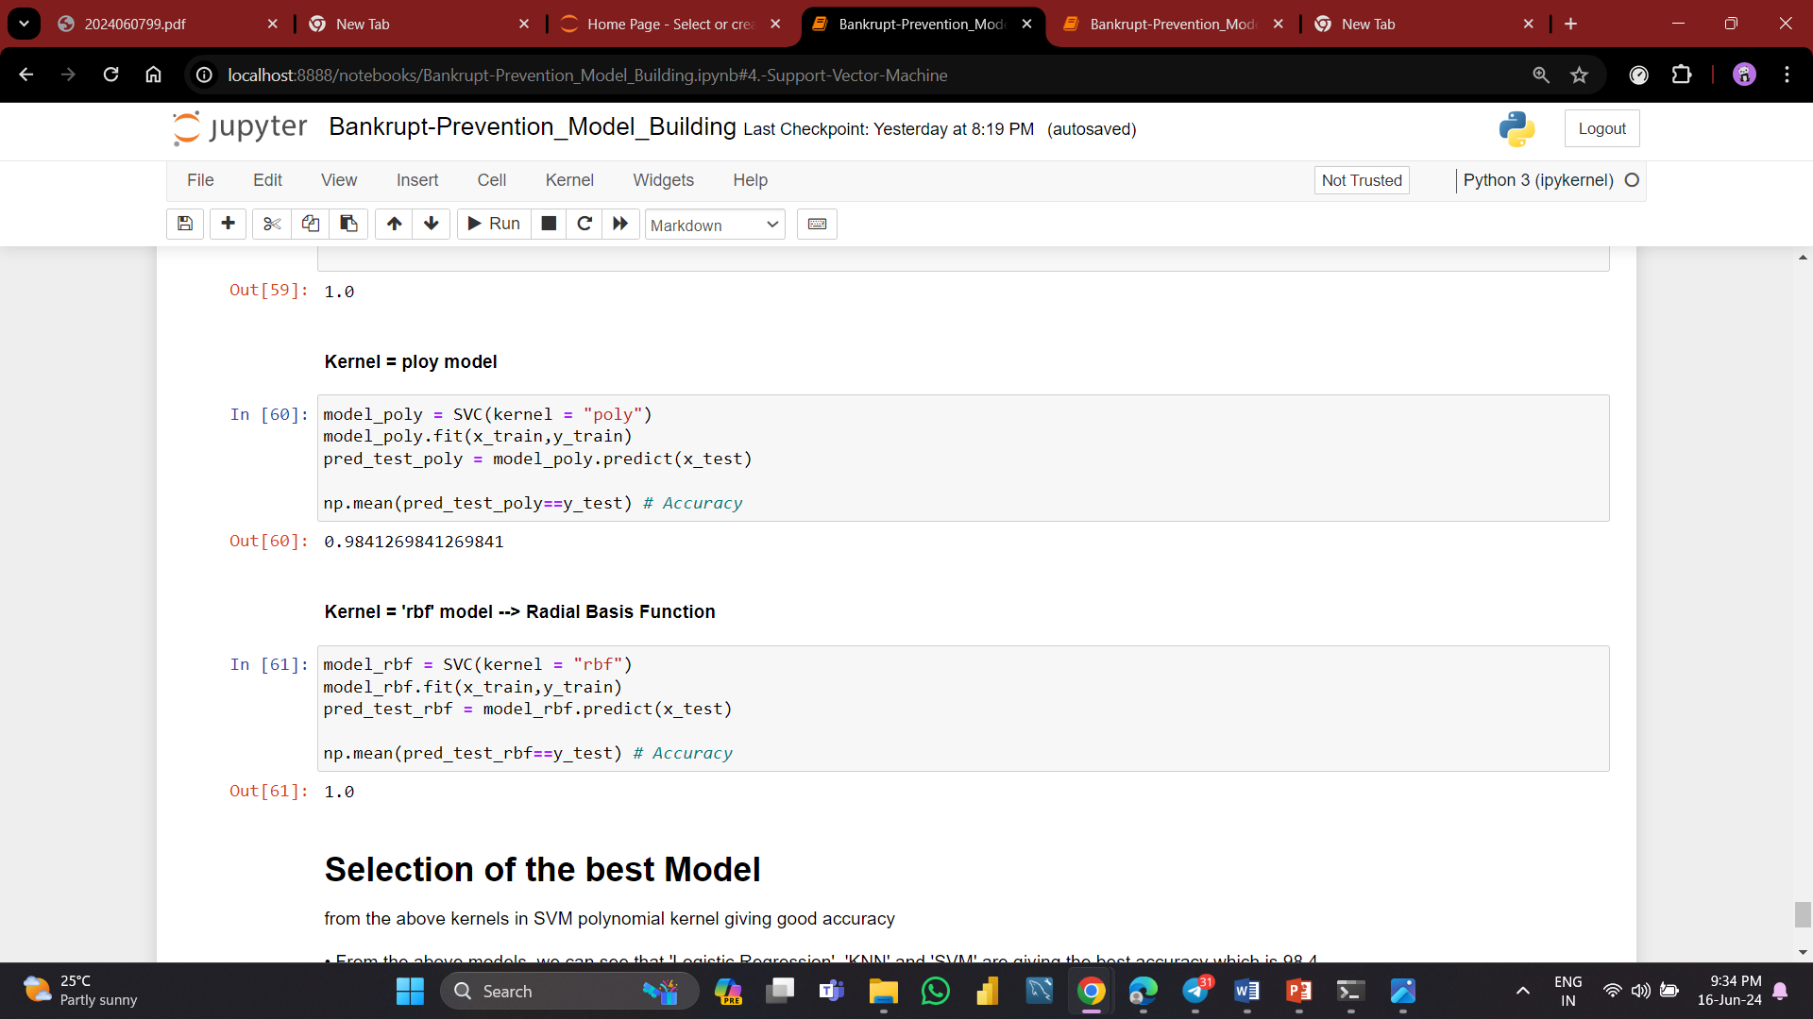
Support Vector Machine
Support Vector Machines (SVM) are a cornerstone of machine learning for both classification and regression tasks.
They are particularly known for their effectiveness in high-dimensional spaces and their ability to handle both linearly and non-linearly separable data through the use of kernel tricks.
The importance of SVMs in various applications from text and image classification to bioinformatics and financial analysis highlights their broad applicability and enduring relevance in modern data science.

Slide 13
Model Performance
Interpretation and Insights:
Perfect Scores:
Algorithms like Logistic Regression, Gaussian-NB, Multinomial-NB, Bernoulli-NB, and Random Forest Classifier score a perfect 1.000000 in both accuracy and precision.
This suggests that these models are particularly well-suited to the data they were trained on, showing no misclassifications and complete identification of all positive and negative instances.
High Precision with Slightly Lower Accuracy:
KNN, Decision Tree Classifier, and SVC show a consistent pattern of high precision but slightly lower accuracy.
This indicates these models are very good at identifying true positive instances but may have a few errors in classifying some cases, which impacts the overall accuracy.
Balanced Performance:
All the algorithms demonstrate either perfect or near-perfect performance, suggesting that the dataset may be highly separable, allowing various models to achieve high classification metrics.

Slide 14
Selection of Best Model

Slide 15
Thank You

